Slide 1



Introduction to Cyber Security
An essential practice for protecting digital systems.

Slide 2

What is cyber security?
Cyber security involves protecting systems, networks, and data from digital attacks.
It includes implementing policies and practices to prevent unauthorized access and cyber threats.

Slide 3
Top 10 Most Notorious Hackers Of All Time In This Internet World
1
Kevin Mitnick
2
Adrian Lamo
Social engineering expert
Responsible for high-profile security breaches
3
Albert Gonzalez
4
Robert Tappan Morris
Mastermind behind the largest data breaches in history
Created the first computer worm

Slide 4

Introduction To Networking
An overview of the fundamental concepts and principles of networking.

Slide 5
OSI MODELS
Layers of Communication
Standardization
Defines the process of how data is transmitted over a network.
Allows for seamless communication between different types of computer systems.

Slide 6
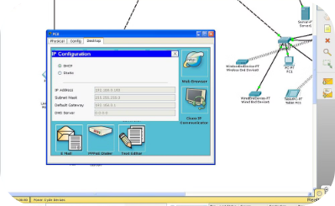
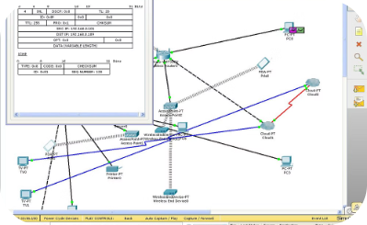
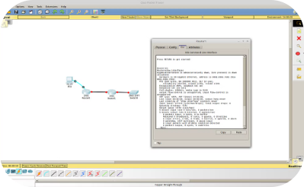
DASHBOARD OF CISCO PACKET TRACER
Workspace Layout
Simulation Tools
Device Library
The dashboard consists of workspace area for network design and configuration.
Various simulation tools for testing network scenarios and configurations.
Extensive device library with routers, switches, and other network components.

Slide 7

What is Python
Python is a high-level, interpreted programming language known for its simplicity and readability.

Slide 8
DATA TYPES IN PYTHON
Integer: Represents whole numbers
Float: Represents decimal numbers
String: Represents text
List: Represents a collection of items

Slide 9
Top 10 Web Application Security Risks
1
Injection
Unvalidated user input to execute unauthorized commands.
2
Broken Authentication
Improperly managed logins and sessions can lead to unauthorized access.
3
Sensitive Data Exposure
Improperly protected sensitive data, leading to security breaches.

Slide 10
Conclusion and Key Takeaways
Key points to remember from the presentation.

